Slide 1
Roles and Responsibilities of Key stakeholders for CBNAAT EQA implementation

Slide 2
Central TB Division - CTD
Policy Decision
Program Guidance
Support states and sites in implementation of testing by procuring and providing equipment, cartridges and reagents
Program monitoring

Slide 3
National Tuberculosis Institute (NTI)
Preparation of CBNAAT EQA PT Panels using dried tube specimen (DTS) technology
Sensitization on EQA activities to stakeholders
Dispatch of panels to CBNAAT sites
Receive compiled data and analyze it
Release PT performance evaluation report to individual sites
  copy to respective IRL/STDC, STO and NRL
Prepare report of PT round
  overall round and
  for respective states
  Report to CTD
On going monitoring of CBNAAT activities including EQA

Slide 4
National Reference Laboratory – NRL’s (1)
Provide training
  Including on site hand holding & guidance to IRL team
Monitor monthly indicators’ data
  Collect, compile and analyze the data
  Monitor the performance of CBNAAT sites in coordination with IRL
  Provide feedback on analyzed data to the IRLs
  Send periodic reports to CTD
  Escalate issues to higher level which are not getting resolved

Slide 5
National Reference Laboratory – NRL’s (2)
Monitor use of cartridges and logistics, and timely calibration/Xpert check of CBNAAT equipment
On site evaluation visits to CBNAAT sites in coordination with IRL
  Provide guidance for trouble shooting

Slide 6
National Reference Laboratory – NRL’s
Support in conduct of PT round
  Participate in PT round
  Support IRLs in orienting their CBNAAT sites on preparations for EQA round
  Monitor progress of CBNAAT EQA PT round and cross check quality of data from IRLs
  Carry out post EQA site visit in coordination with IRL
  Tracking, follow up with IRL’s and assist to resolve the issues which were found in CBNAAT EQA implementation

Slide 7
State TB Cell (STC)
Over all Leadership for all the sites in state
Overall management of CBNAAT sites
  Ensuring all sites are functional and monitor calibration of equipment
  Ensuring cartridges and logistics are available
  All sites are adequately staffed with trained manpower
  Coordination at higher level if issues are not resolved
  Supporting STDC/IRL for monitoring & training activities
  Encouraging & enrolling new sites (incl. pvt. sites) in programme
Supervisory & monitoring activities

Slide 8
State TB Demonstration & Training Center (STDC)
Intermediate Reference Laboratory (IRLs) (1)
Provide Training
  Hands on CBNAAT training
  Nikshay entry training
Monitor monthly indicators’ data
  Collect, compile and analyze the data
  Monitor the performance of CBNAAT site in coordination with DTO
  Provide feedback to CBNAAT sites on analyzed data
  Send periodic reports to STO and NRL
  Escalate issues to higher level which are not getting resolved
Monitor use of cartridges and logistics, and timely calibration/ Xpert check of CBNAAT equipment

Slide 9
State TB Demonstration & Training Center (STDC)
Intermediate Reference Laboratory (IRLs) (2)
On site evaluation visits to CBNAAT sites in coordination with DTO
  Provide guidance for trouble shooting
Support in conducting PT round
  Participate in PT round
  Update the CBNAAT site details
  Guide CBNAAT sites on EQA activity
  Compile the CBNAAT EQA data from all sites and cross check
  Carry out post EQA site visit in coordination with NRL & NTI
  Tracking, follow up and assist CBNAAT sites to resolve the issues which were found in CBNAAT EQA implementation
  Prepare action taken report to the problems identified in the EQA.

Slide 10
District TB Officer (DTOs)
Over all leadership for all the sites in the district
Overall management of CBNAAT sites in the district
  Ensuring all sites are functional and monitor calibration of equipment
  Ensuring cartridges and logistics are available
  All sites are adequately staffed with appropriately trained manpower
  Coordination at higher level if issues are not resolved
  Supporting STDC/IRL for monitoring & training activities
  Encouraging new sites (incl. pvt. sector) to participate in programme
Supervisory & monitoring activities

Slide 11
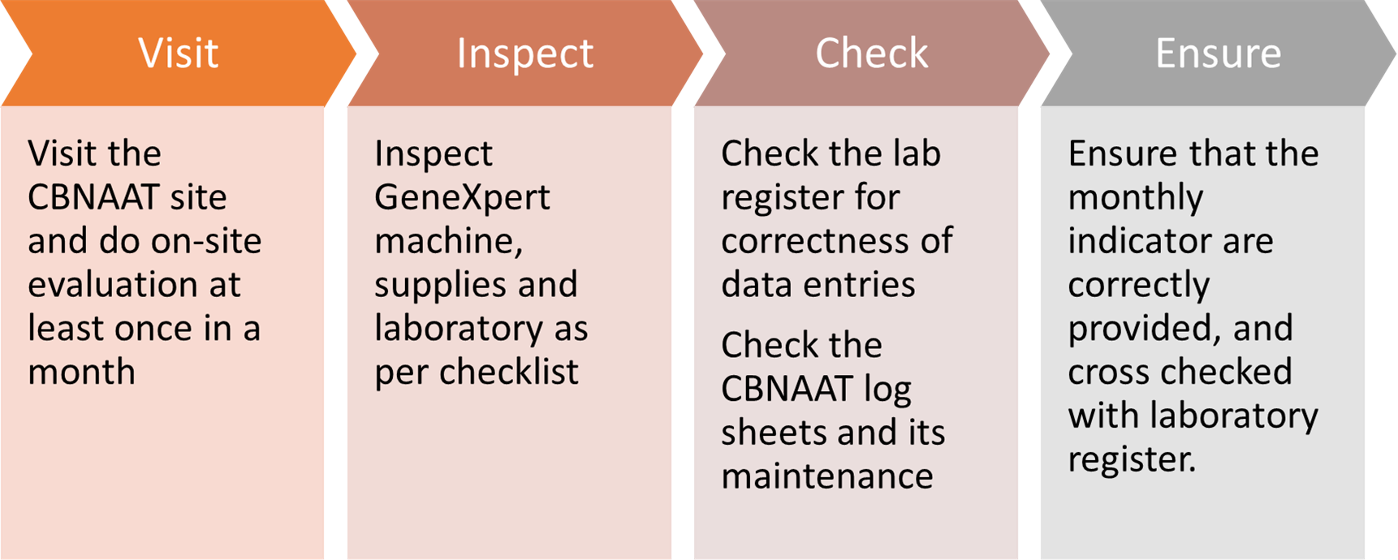
Senior TB Laboratory supervisor - STLS

Slide 12
Laboratory Technician - LT
Testing:
  Ensure proper specimen collection
  Ensure proper sputum processing and testing as per SOPs
  Provide accurate and timely results for samples received at the site for CBNAAT testing
  Ensure proper recording and reporting
Maintenance
  To keep laboratory and work benches clean
  To follow good laboratory practices (i.e. no eating, no drinking & no smoking inside the lab)
  Perform Daily, weekly and monthly maintenance of equipment including data archival
Safe disposal of all contaminated materials
Share monthly indicators on time and follow guidance provided by IRLs and DTO
Perform testing of PT panels as per protocol and submit the results

Slide 13
Thank You

